Slide 1
Native Californians and The Portola Expedition
1769

Slide 2
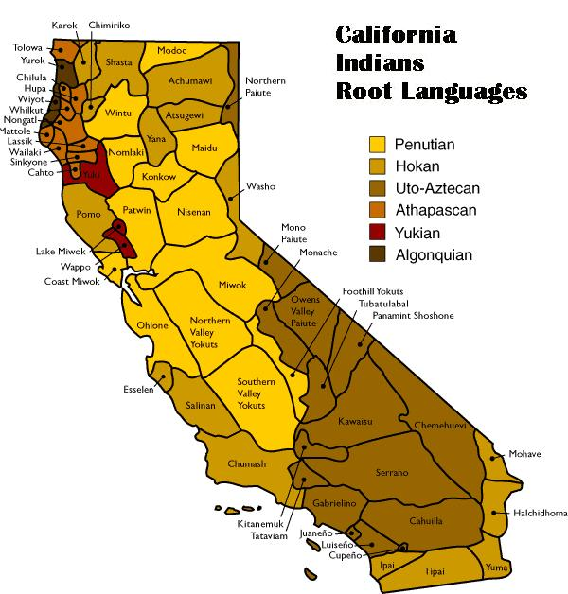
Native Americans in California
Notes:
Image retrieved from: https://www.parks.ca.gov/?page_id=23545

Slide 3
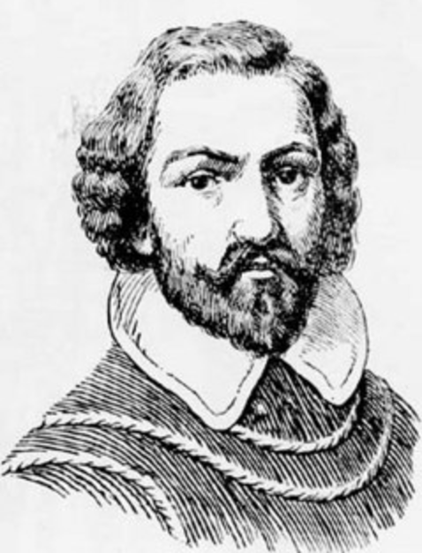
Spanish Exploration: Cabrillo, 1542
Notes:
Image retrieved from: https://commons.wikimedia.org/wiki/File:Juan_Rodr%C3%ADguez_Cabrillo.jpg

Slide 4
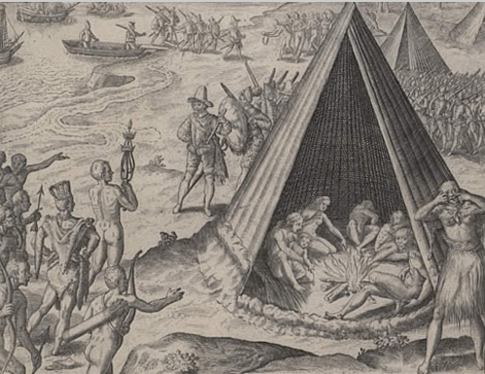
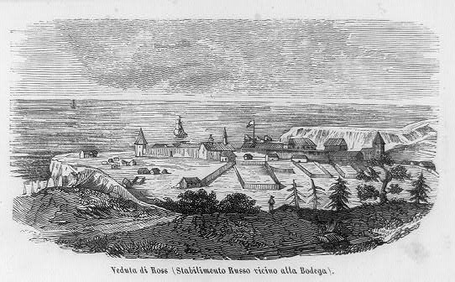
English and Russian Exploration
Sir Francis Drake landing
in California, 1579
Engraving by Theodor de Bry, 1590
Fort Ross: Established in 1812
Notes:
Image retrieved from: http://bancroft.berkeley.edu/Exhibits/nativeamericans/lg13.html (https://en.wikipedia.org/wiki/Francis_Drake)
Image retrieved from: https://www.loc.gov/item/2004673140/

Slide 5
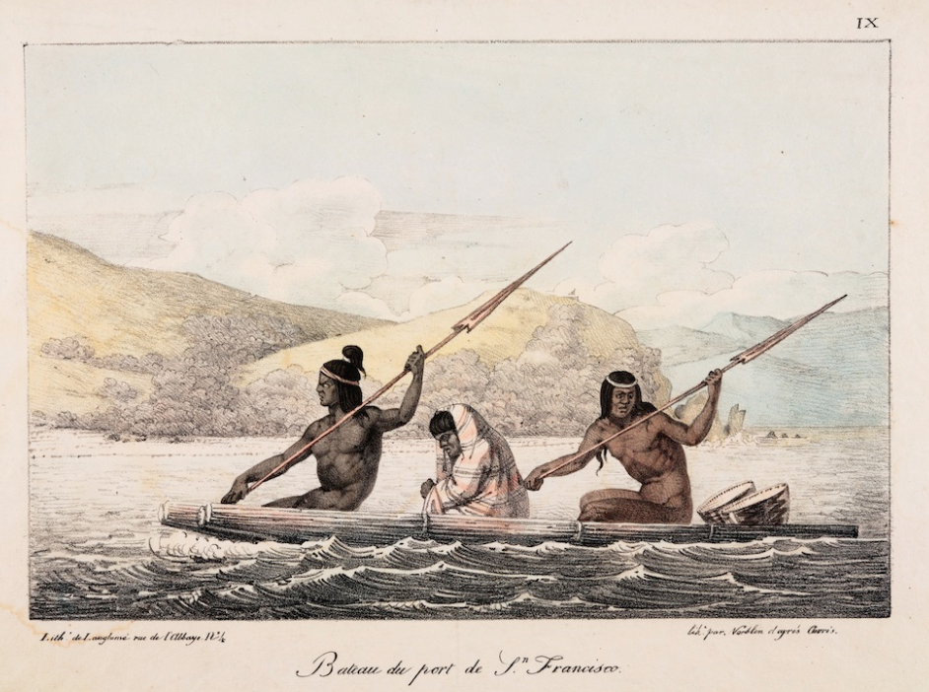
Image A
Louis Choris, “Boat in the Port of San Francisco,” 1816.
Choris was a German-Ukrainian artist who traveled to Northern California as part of a Russian expedition in 1816. The people in the image were most likely Coastal Miwok or Ohlone Indians.
Notes:
Retrieved from: https://calisphere.org/item/ark:/13030/tf6p3008w7/

Slide 6
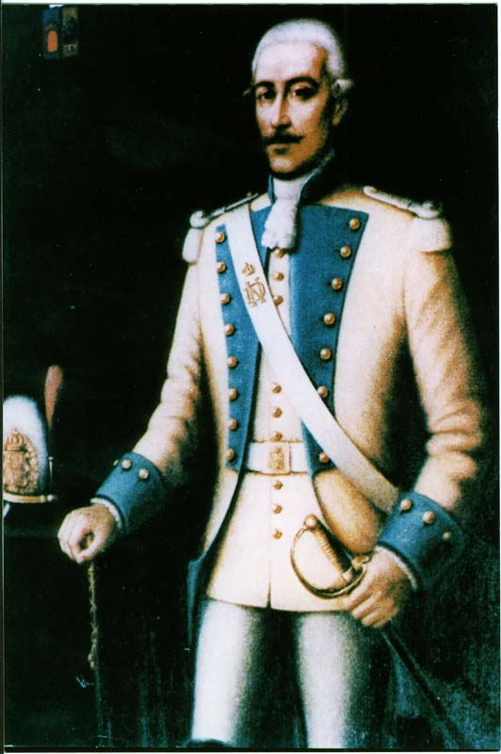
The Portola Expedition, 1769
Gaspar de Portola
Notes:
Retrieved from: http://www.historicmonterey.org/people/don-gaspar-portola/

Slide 7
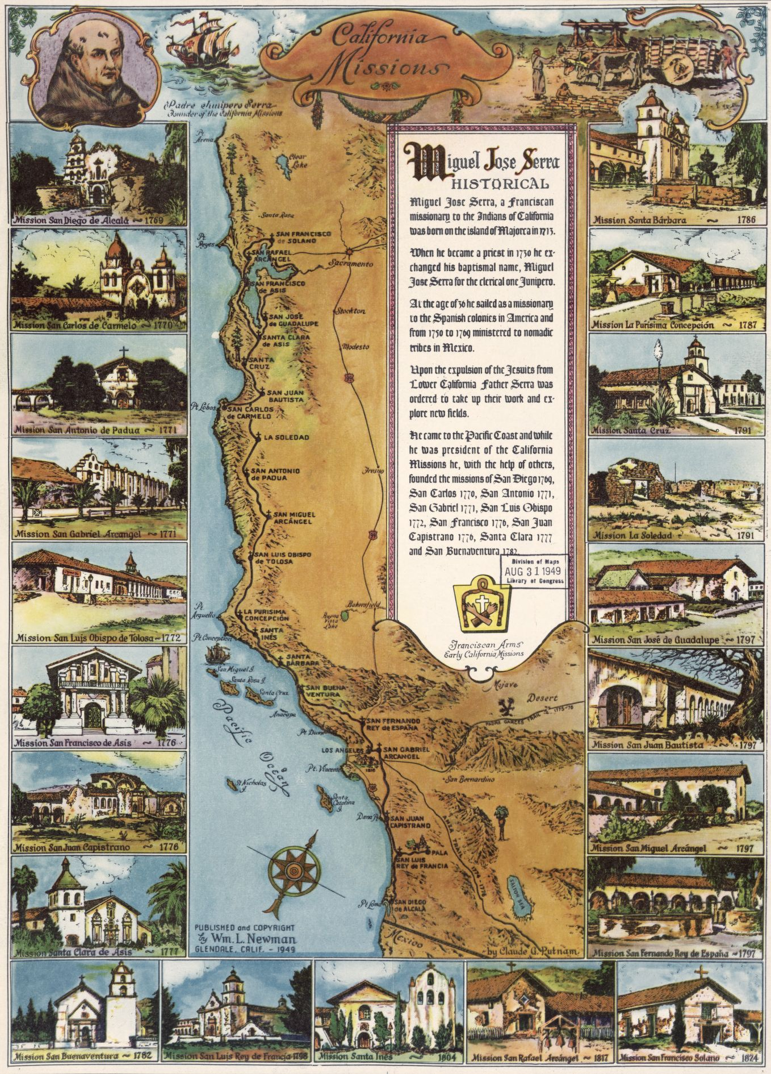
California Missions
Notes:
Retrieved from: https://www.loc.gov/item/2008627969/

Slide 8
Central Historical Question
What do diary entries tell us about the purpose of the Portola Expedition and Native Americans in California at the time?

Slide 9
Native Americans in California
Notes:
Image retrieved from: https://www.parks.ca.gov/?page_id=23545

